Slide 1
Case Study on Apple Music
Jing Ding
Jamie (Hanqing) Huang
Xiaoting (Theresa) Liu
Xiangwen (Jessica) Meng
Prabin Nyaupane

Slide 2
Project Content
Background Overview
Problems Statement
Model Selection
Solution Process
Softwares
Visualizations
Researches
Result Interpretations
Situation Comparison
Conclusion
Recommendations
Reference

Slide 3
Apple Music Overview
Background
A music and video streaming service
Developed by Apple Inc.
Pricing Model
Single License
US$9.99 per month
US$99.00 per year
Family License: US$14.99 per month
Student License: US$4.99 per month
Competitors
Spotify
Amazon
Google Play

Slide 4
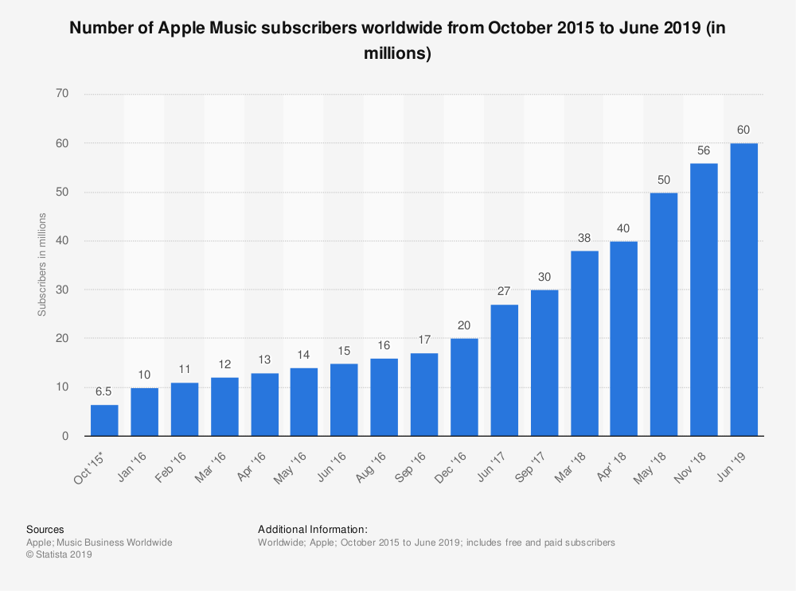

Subscriber Trend of Apple Music
Reference: In Statista. Retrieved July 26, 2019, from https://www.statista.com/statistics/604959/number-of-apple-music-subscribers/

Slide 5
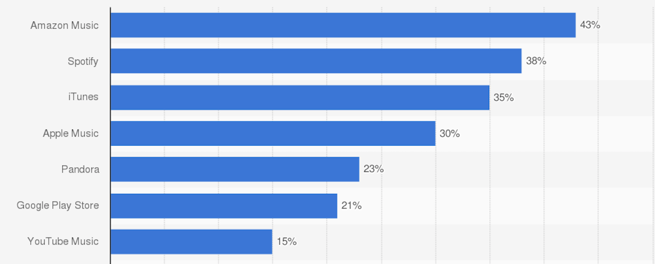
Music Streaming Service
Customer’s Purchase of Music Downloads or Streaming Service in The Past 12 Months
In Statista. Retrieved July 26, 2019, from https://www.statista.com/forecasts/997101/digital-music-purchases-by-brand-in-the-us

Slide 6
Music Streaming Service Comparison
 | Apple | Spotify | Google Play | Amazon
Monthly Fee | $9.99 | $9.99 | $9.99 | $9.99; $7.99 with Prime
Free Option | No | Yes, with ads | Yes | Yes, with ads
Free Trial Period | 3 months | 30 days | 30 days | 30 days
Music Library Size | 50 million | 50 million | Over 40 million | 50 million
Maximum bitrate | 256Kbps | 320Kbps | 320Kbps | 256Kbps
Family Plan | $14.99/month for up to 6 users | Up to $5/month/user | $14.99/month up to 6 users | $14.99/month up to 6 users
Student Discount | Yes | $4.99 (US Only) | No | No
Offline Listening | Mobile Only | Mobile & Desktop | Mobile only | Mobile & Desktop

Slide 7




Problem
Statement
Problem Identification
Decreased Market Share
Strong competitors such as Spotify
Low Competitiveness
Hard to seize own market share
Success Criteria
Short-term: Identify possible opportunities to attract potential customers
Long-term: Increase in subscribers by 15% within one year

Slide 8
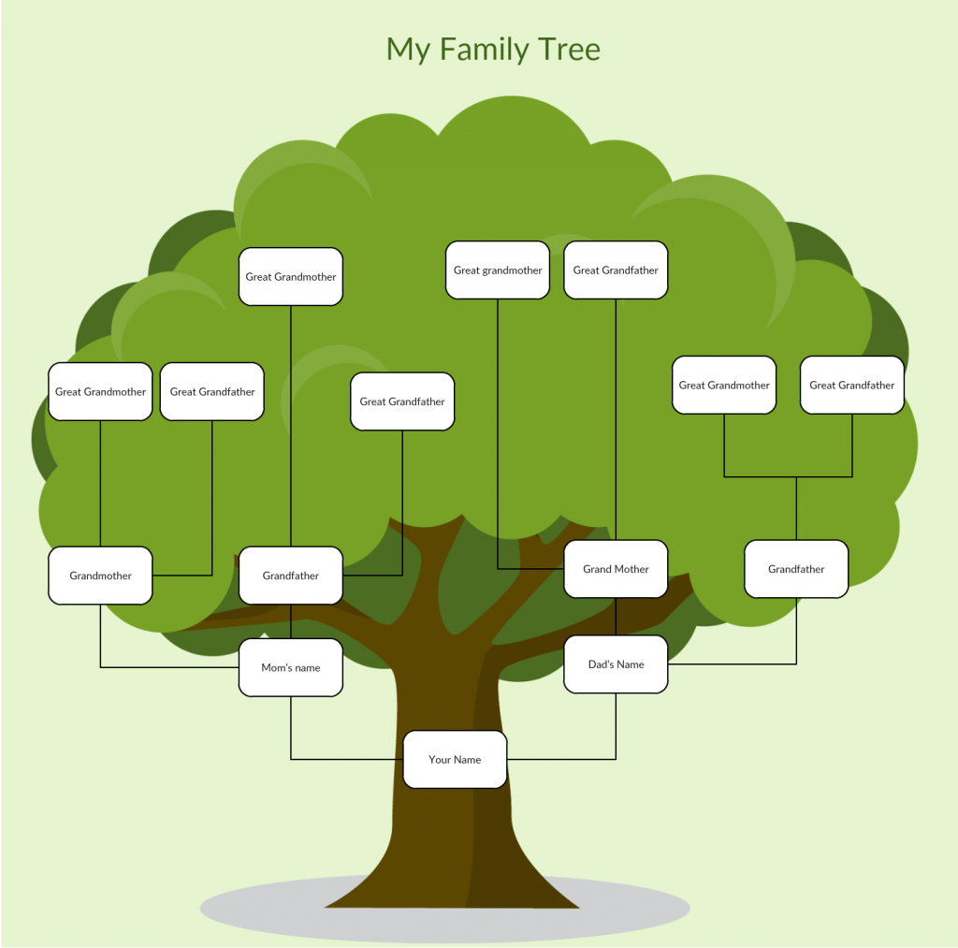

Model Selection
Twitter Sentiment Analysis (R)
Dataset retrieved from Twitter
Social Media Sentiment
Informative Analysis (R)
Dataset retrieved from survey
Decision Tree Classification

Slide 9
Solution Process
Twitter Sentiment Analysis (R)
Data Collection
Twitter
Survey
Twitter Sentiment Analysis
Analysis Result Comparison
Conclusion
&
Recommendation
Decision Tree Classification
Model

Slide 10
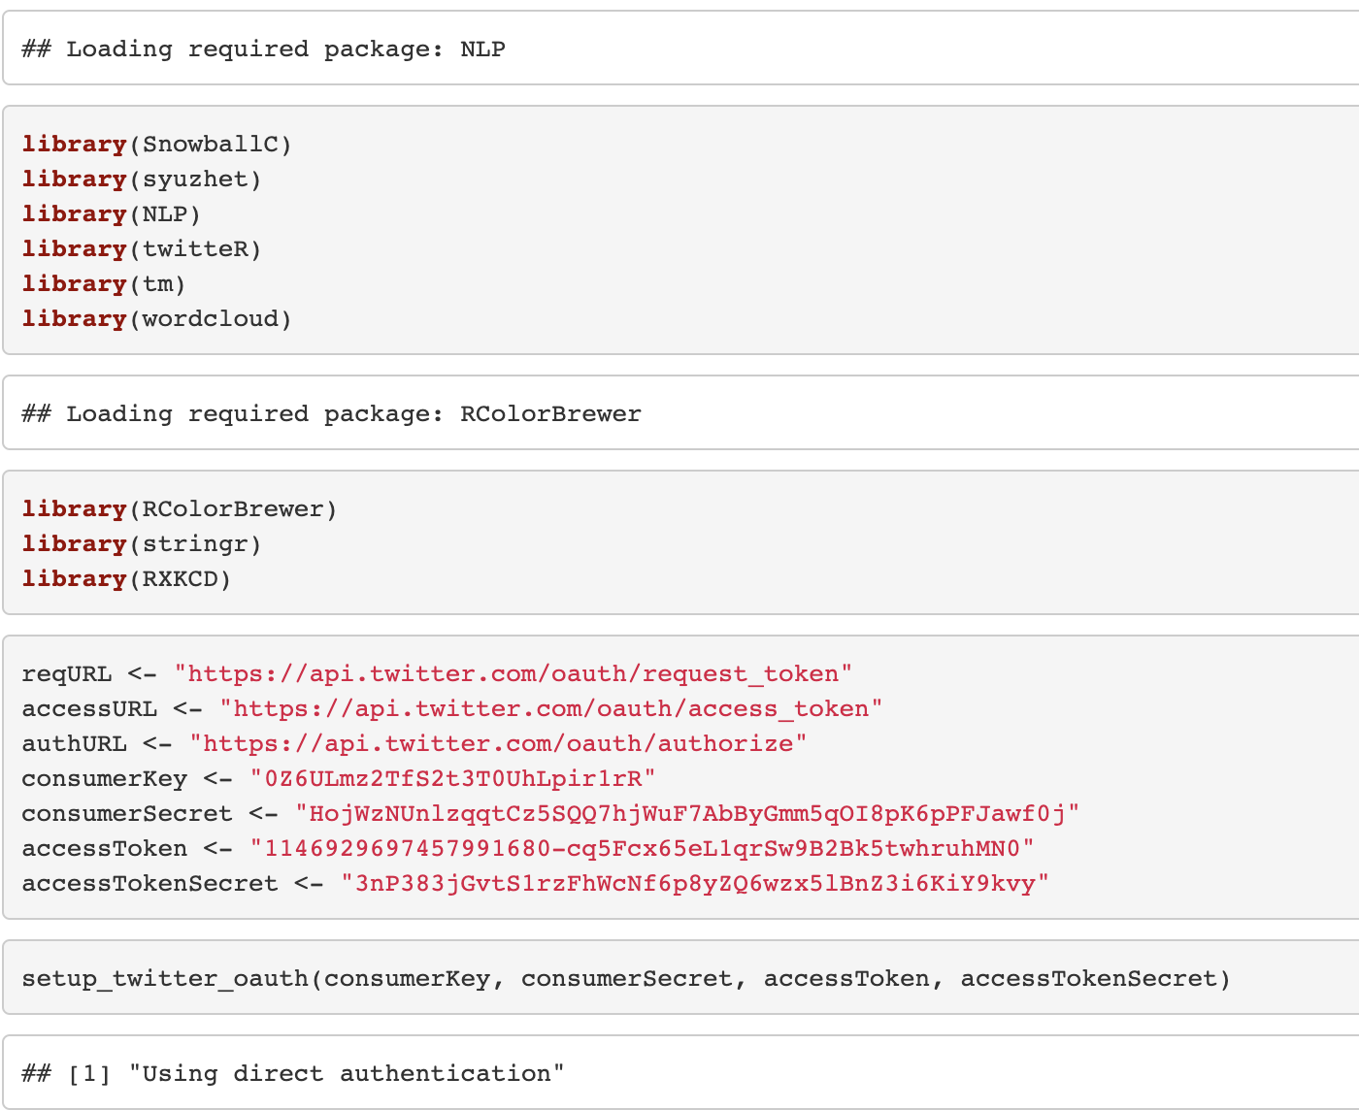
Software
Twitter Sentiment Analysis (R)
Setting up API access to Twitter data
Installing required packages in R & loading libraries
Setting up twitter authorization in R

Slide 11
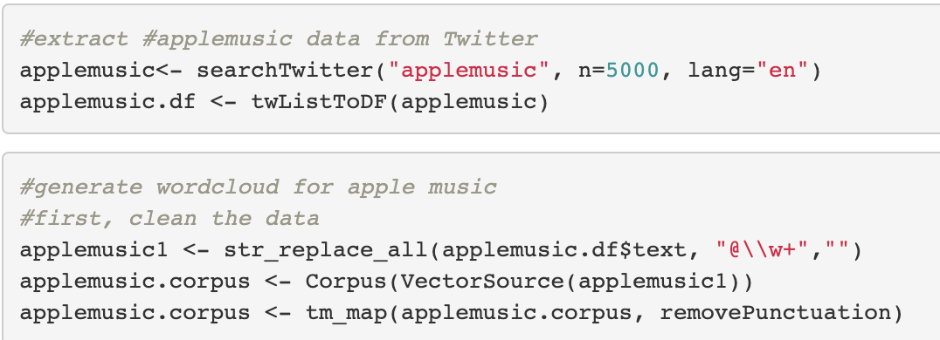
Software
Twitter Sentiment Analysis (R)
Extracting Apple Music’s data from Twitter & cleaning up data

Slide 12
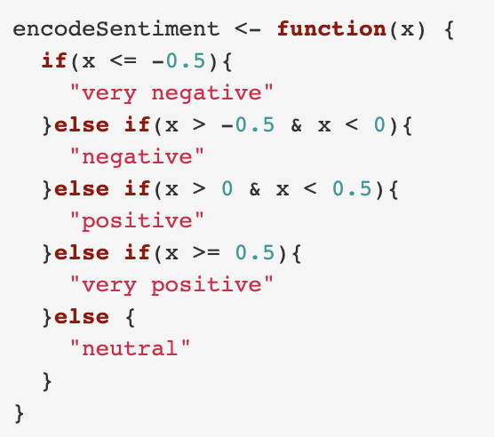
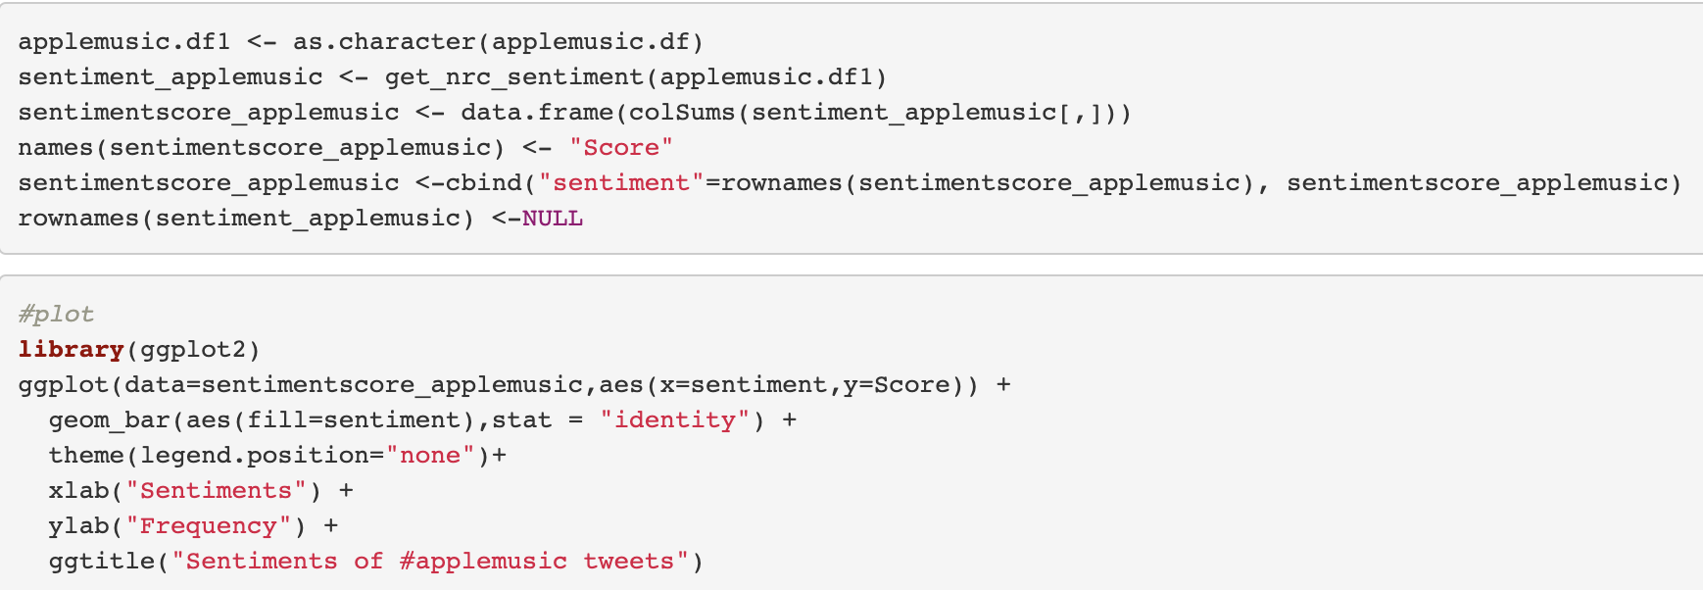
Software
Twitter Sentiment Analysis (R)
Encoding sentiment using IF THEN ELSE function

Slide 13
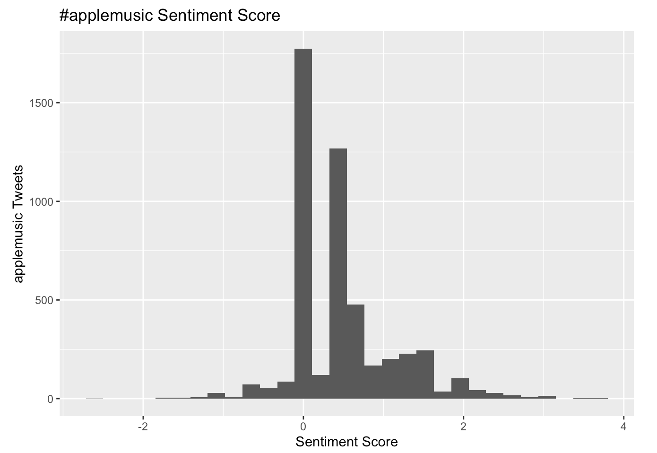
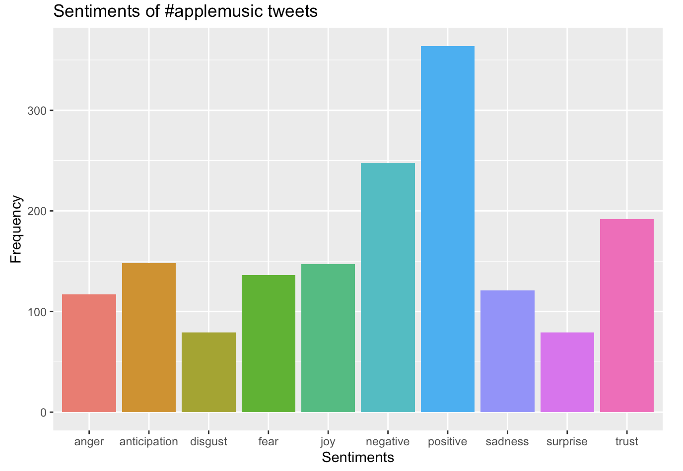
Visualization
Twitter Sentiment Analysis (R)
Summary
Most of the tweets are either neutral(i.e. score of o) or higher (i.e. score greater than 0)
Sentiment Frequency scores shows different emotions
(i.e. anger, anticipation, disgust, fear, joy, negative, positive, sadness, surprise and trust)

Slide 14
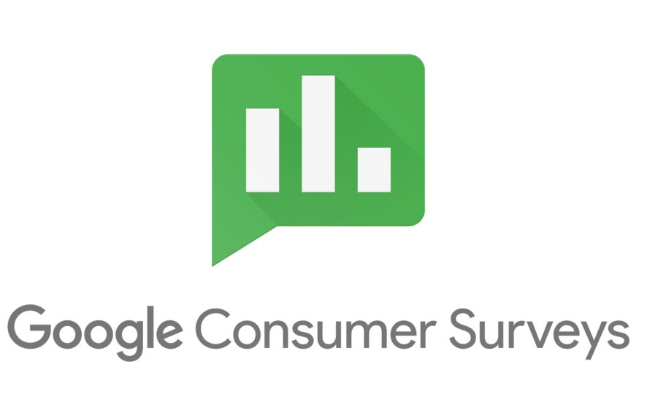
Research
Survey & Informative Analysis (R)
Demographics
Age / Gender
Education Level / Household Size
Employee Status / Income
User Preferences
Music Preference
Rate Preference
Mobile System Preference
User Behavior Preference
Competitor Analysis (such as Spotify)
Sentiment Degree (Score from 1 to 7)

Slide 15
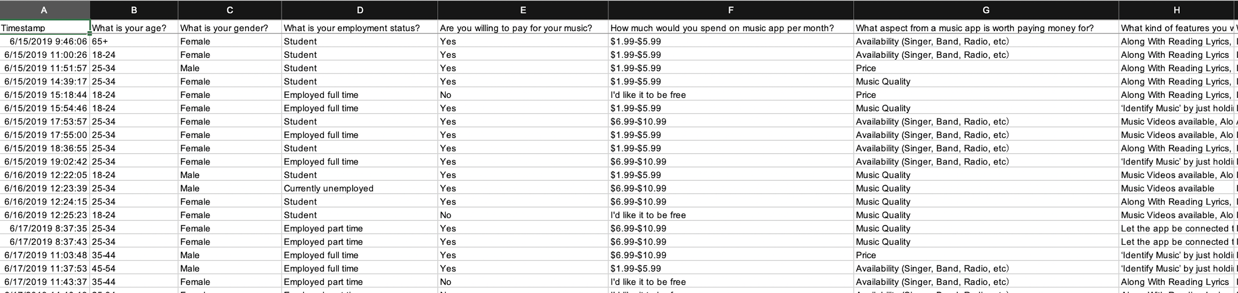
Research
Survey & Informative Analysis (R)
Snapshot of Survey Dataset

Slide 16
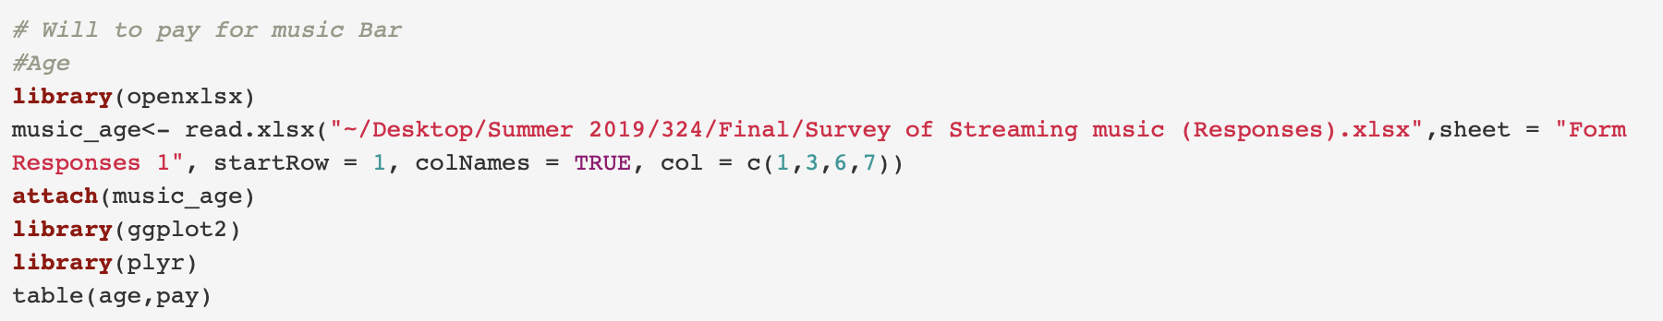
Software
Informative Analysis (R)
Loading visualizing libraries such as "ggplot2" and "plyr"
Age Comparison Analysis: using ggplot to show purchase willingness of streaming music

Slide 17
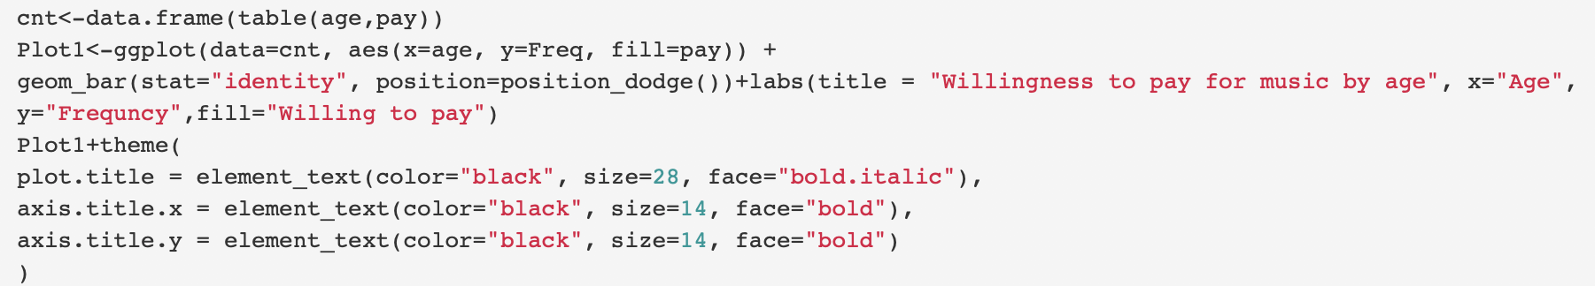
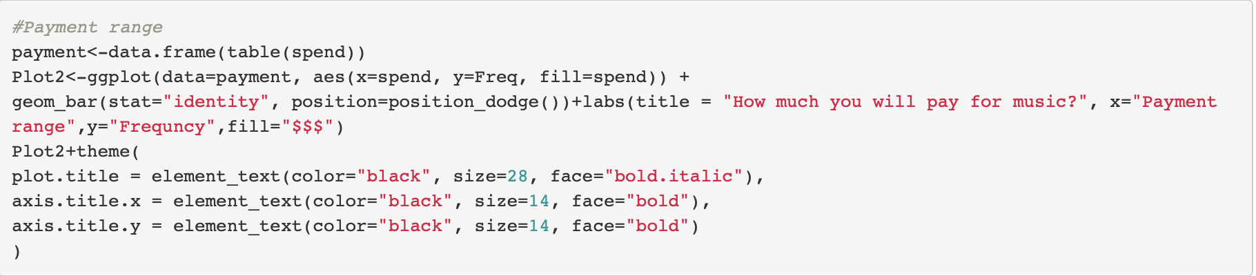
Software
Informative Analysis (R)
Customer Demand Analysis: purchase willingness of function preference
Rate Preference Analysis: using ggplot to show the rate range preference

Slide 18
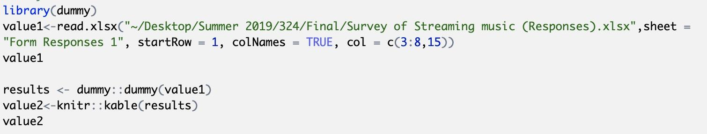
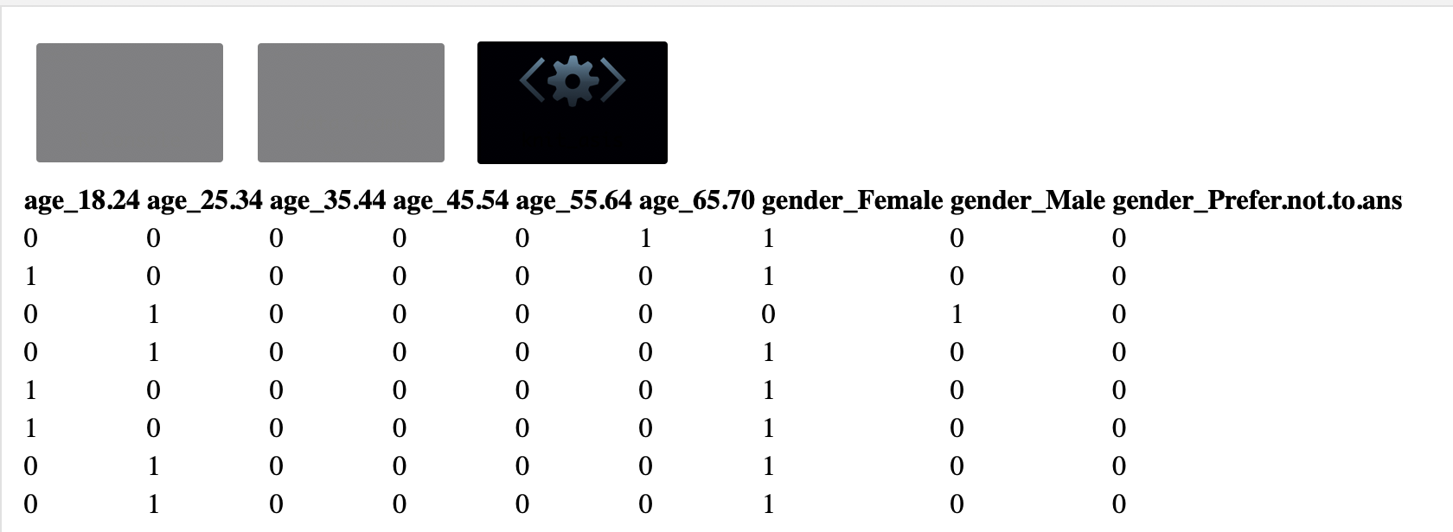
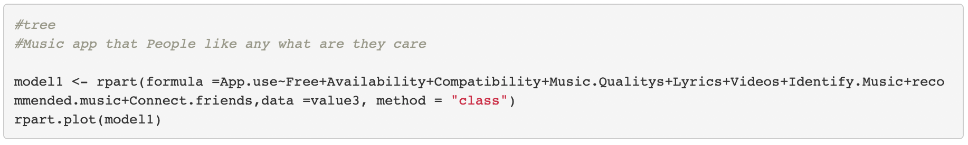
Software
Informative Analysis (R)
Decision Tree Classification Analysis

Slide 19
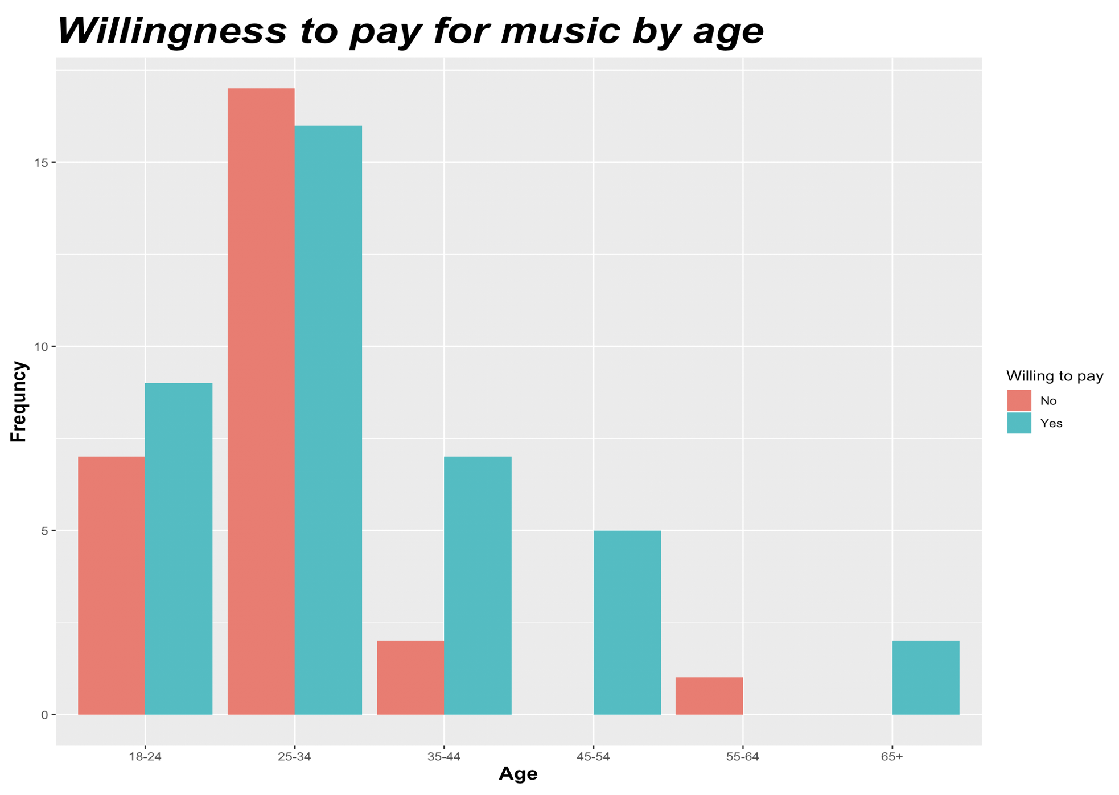
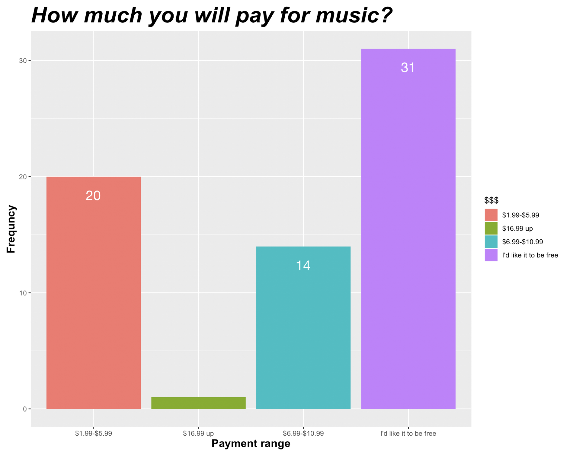
Visualization
Informative Analysis (R)
Age Comparison Analysis
Willing to Pay for Streaming Music (Age-oriented)
Rate Preference Analysis
Willing to Pay for Streaming Music (Price-oriented)

Slide 20
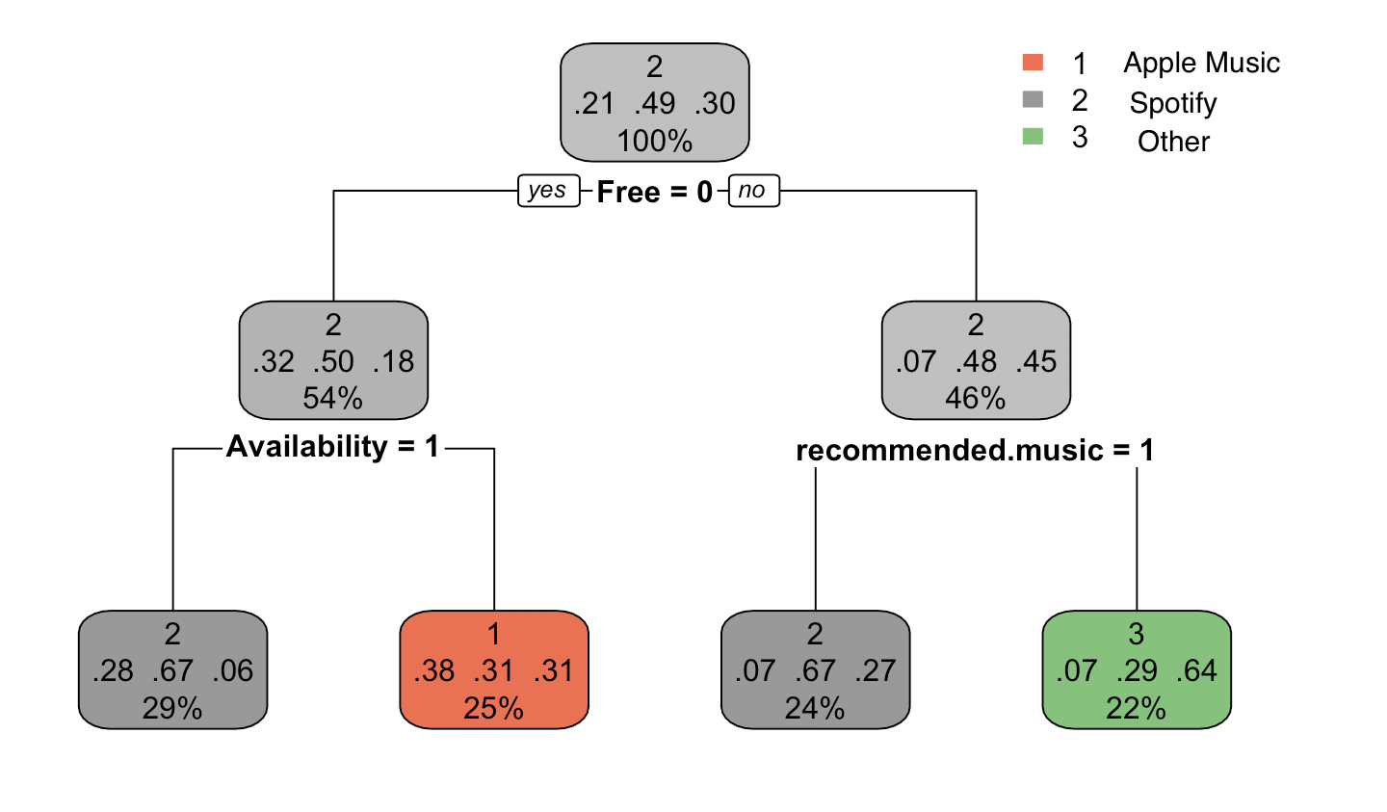
Visualization
Informative Analysis (R)
Y - Music App Preference
X - Potential Variables
Music Quality
Availability (Singer, Band, etc.）
Compatibility
（Like intelligent family system )
Service Rate
Music Video Availability
Reading Lyrics Support
‘Identify Music’ Support
Internet-connected & similar song recommendation based on the user’s playlist
Decision Tree Classification Analysis

Slide 21
Result Interpretation
Twitter Sentiment Analysis (R)
Twitter Sentiment Analysis
Sentiments | Frequency | Comments
Anger | 110
Anticipation | 147
Disgust | 80 | Low
Fear | 135
Joy | 145
Negative | 245 | High
Positive | 370 | Very High
Sadness | 120
Surprise | 80
Trust | 190 | High
Summary on Apple Music
Strong social media presence as positive emotions outweighs negative
Ability to build trust to the customers
Low comment on disgust emotion

Slide 22
Result Interpretation
Informative Analysis (R)
Age | Purchase Willingness (%)
18 - 24 | 56.25%
25 - 34 | 48.48%
35 - 44 | 77.78%
45 - 54 | 100.00%
55 - 64 | 0.00%
65 - 70 | 100.00%
Rate Preference
Rank | Amount | Percentage
No. 1 | Free | 46.97%
No. 2 | $1.99-$5.99 | 30.30%
No. 3 | $6.99-$10.99 | 21.21%
No. 4 | $16.99 and up | 1.52%

Slide 23
Result Interpretation
Informative Analysis (R)
Possible marketing strategies for potential customers
Trial/Free Version
Survey result shows higher percentage of customers prefer free version over quality
2. Customer Segmentation
Age groups over 35 yrs are willing to pay for higher quality
Age groups below 34 yrs prefer free version/cheaper price over quality
3. Music Recommendations
Music recommendations from friends and family are more acceptable

Slide 24
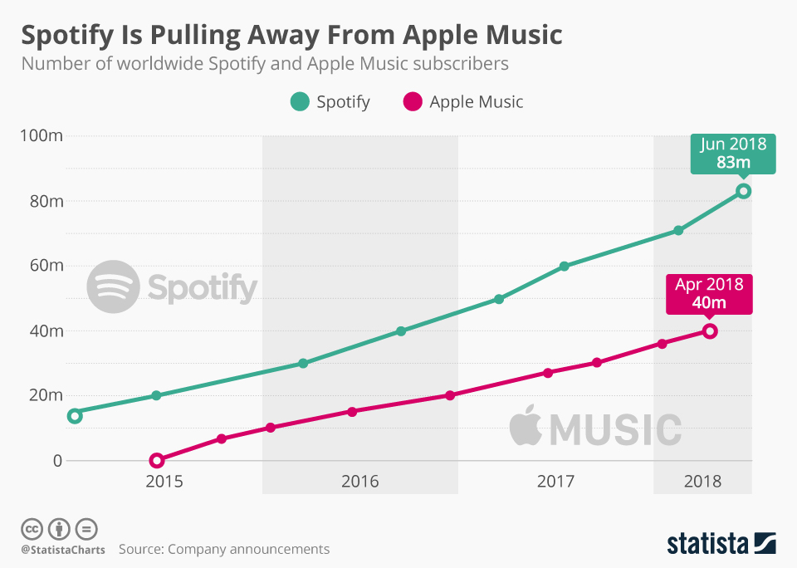

Situation Comparison
Apple Music VS Spotify
Identifying main factors contribute to Spotify
Applying possible marketing strategies learned from Spotify
is pulling away from

Slide 25
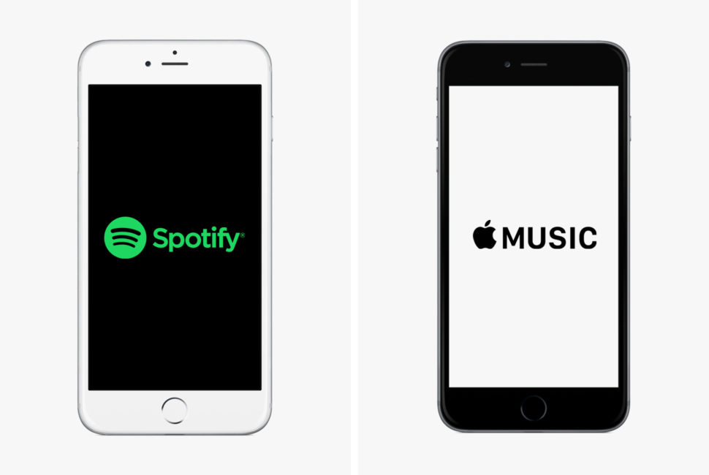
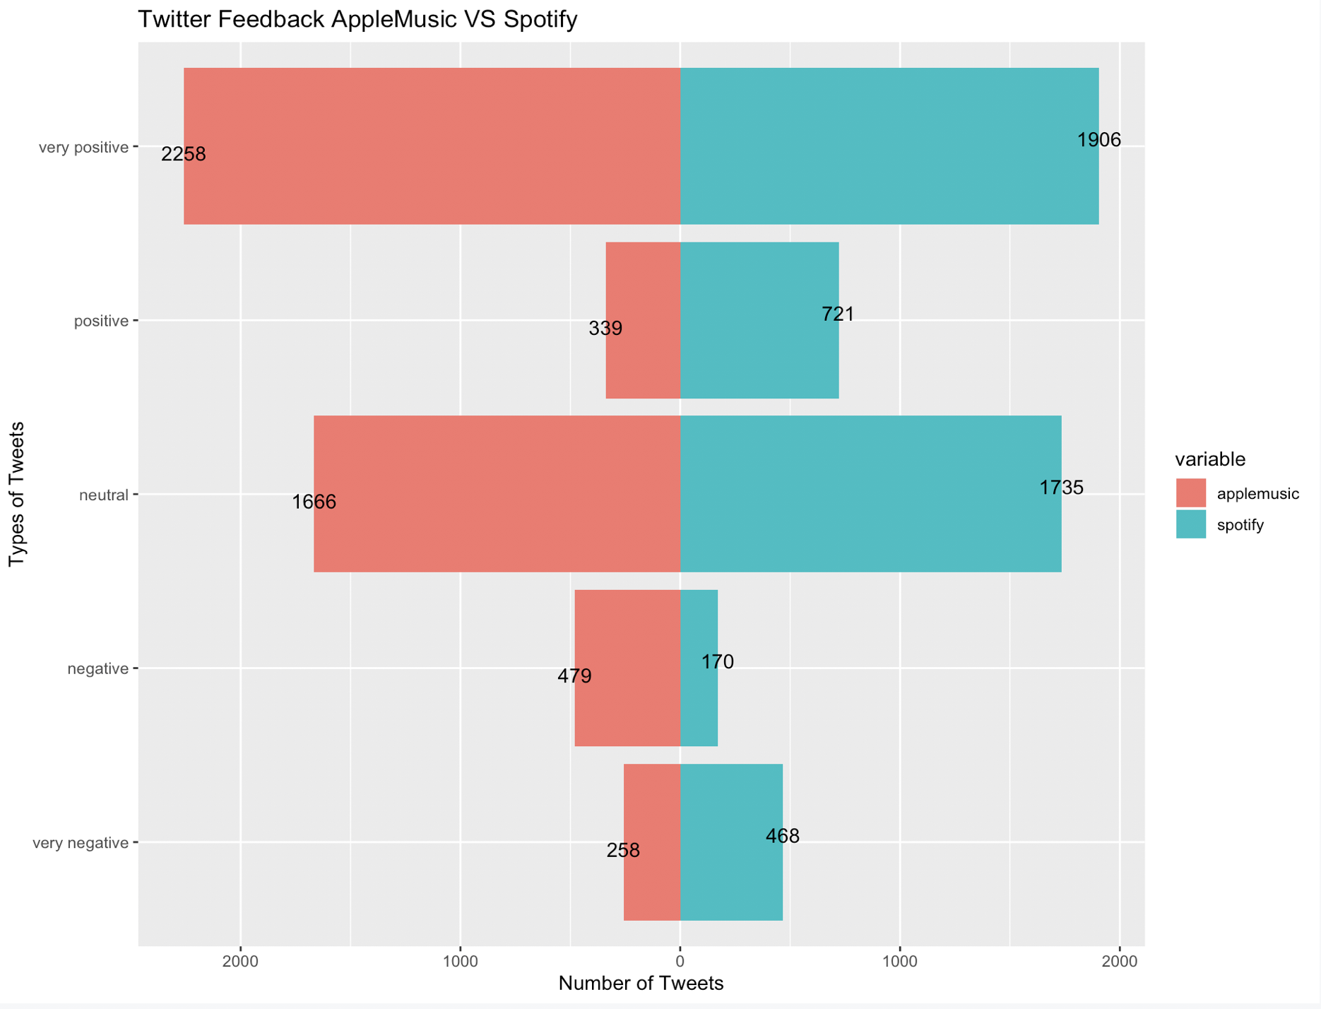
Situation Comparison
Apple Music VS Spotify (Twitter Sentiment Analysis)
Summary
There is no significant difference between Apple Music & Spotify

Slide 26
Situation Comparison
Apple Music VS Spotify (Informative Analysis)
Comparison (1) Trial/Free Version
According to musicbusinessworldwide.com, Free version is a big part of Spotify’s successful business strategy:
Revenues from advertising on its free tier made up just 9.7% of Spotify’s total revenue pie, generating $123m in a single quarter.
Spotify has self service ad which allows free users to skip certain ad but not all. This allows users to choose ads relevant to them.
Free tier really works as a funnel for conversion in the premium side.
Reference
Jones, R. (2018, October 31). Spotify: 'Our ads business is a real trigger for growth'. Retrieved August 01, 2019, from https://www.musicbusinessworldwide.com/spotify-our-ads-business-is-a-real-trigger-for-growth-moving-forward/

Slide 27
Situation Comparison
Apple Music VS Spotify (Informative Analysis)
Comparison (2) Customer Segmentation
Freemium model: Free Spotify access comes with lower sound quality, and advertisements, and requires an internet connection.
Premium model: Listen uninterrupted to high-quality recordings, and download songs to any device on which they have the Spotify app.
This model has helped Spotify claim 36% of the global streaming market.
Reference
Spotify Usage and Revenue Statistics (2019). (2019, May 10). Retrieved August 2, 2019, from https://www.businessofapps.com/data/spotify-statistics/

Slide 28
Situation Comparison
Apple Music VS Spotify (Informative Analysis)
Comparison (3) Music Recommendation
Spotify make great use of machine learning to for its recommendation model.
Spotify uses collaborating filtering models for analyzing behavior, NLP models for analyzing text and Audio models to analyze audios for recommendation.
Spotify is also integrated with Facebook, which make it easier to share songs/playlists and subscribe to what friends are listening
Reference
Behind Spotify's Magical Recommendation Algorithm. (2019, March 02). Retrieved August 02, 2019, from https://nextbigwhat.com/spotify-recommendation-algorithm/

Slide 29
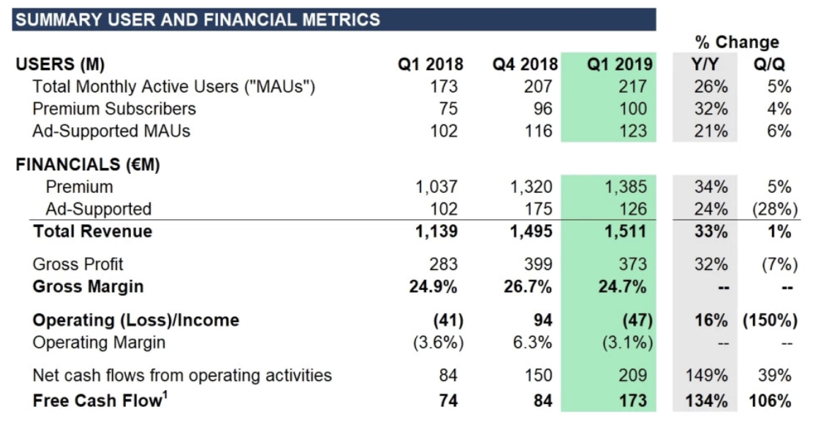
Situation Comparison Apple Music VS Spotify (Informative Analysis)
Spotify Performance in 2019
Important Percentage Changed:
Total monthly active users increased by 26%
Premium subscribers increased by 32%

Slide 30
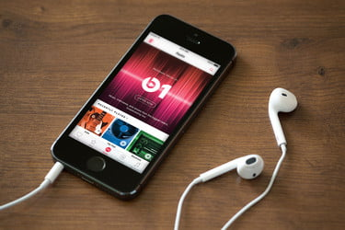
Conclusion
Twitter Sentiment Analysis
Situation comparison does not agree with market research
Informative Analysis
Situation comparison agrees with market research
Short-term Success Criteria
Successfully identified three main factors for potential customers increase.
Long-term Success Criteria
Successfully reach 15% growth of market share.

Slide 31
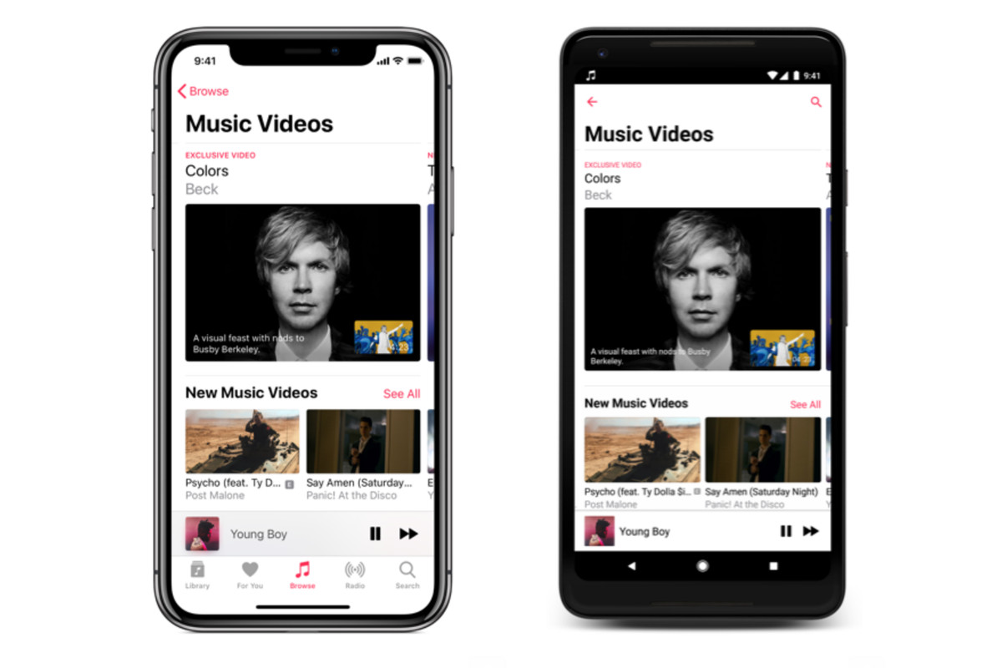
Recommendation
Apple Music’s
Possible Developing Strategies
Exploring revenues by employing ads on trial/free versions
Acquiring market share by proper marketing segmentation
Improving recommendation system by integrating big data & Machine Learning

Slide 32
Reference
Behind Spotify's Magical Recommendation Algorithm. (2019, March 02). Retrieved August 02, 2019, from https://nextbigwhat.com/spotify-recommendation-algorithm/
Carman, A., February 6th, 2019. What Spotify needs in order to become a great podcast app. Retrieved from https://www.theverge.com/2019/2/6/18213743/spotify-gimlet-media-anchor-podcast-app
Cuofano, G. November 6th, 2018. How Does Spotify Make Money? Spotify Business Model In A Nutshell. Retrieved from https://fourweekmba.com/spotify-business-model/#Spotify_key_metrics
Iqbal, M. May 10th, 2019. Spotify Usage and Revenue Statistics (2019). Retrieved from https://www.businessofapps.com/data/spotify-statistics/#3
Jones, R. (2018, October 31). Spotify: 'Our ads business is a real trigger for growth'. Retrieved August 01, 2019, from https://www.musicbusinessworldwide.com/spotify-our-ads-business-is-a-real-trigger-for-growth-moving-forward
Music Business Worldwide. (June 27, 2019). Number of Apple Music subscribers worldwide from October 2015 to June 2019 (in millions) [Chart]. In Statista. Retrieved July 26, 2019, from https://www.statista.com/statistics/604959/number-of-apple-music-subscribers/

Slide 33
Reference
SAVVIDES, L. and ORELLANA, V., June 11th, 2019. Spotify vs. Apple Music: Which music streaming service to choose? Retrieved from https://www.cnet.com/news/apple-music-vs-spotify-comprison-best-music-streaming-service/
Spotify Usage and Revenue Statistics (2019). (2019, May 10). Retrieved August 2, 2019, from https://www.businessofapps.com/data/spotify-statistics/
Statista. (April 23, 2019). Which of these providers have you bought music downloads or streaming services from in the past 12 months? [Chart]. In Statista. Retrieved July 26, 2019, from https://www.statista.com/forecasts/997101/digital-music-purchases-by-brand-in-the-us
T.P et XIOMARA.B., June 20th, 2019. Best music streaming service of 2019: Spotify, Pandora, Apple Music, Amazon and Google Play compared. Retrieved from https://www.cnet.com/how-to/best-music-streaming-service-of-2019/
Venturebeat.com, Aprial 29th, 2019. Spotify passes 100 million premium users as revenue climbs 33% YoY. Retirved from https://venturebeat.com/2019/04/29/spotify-passes-100-million-premium-users-as-revenue-climbs-33-yoy/
Wang, A., February 6th, 2019. Spotify Turns a Profit for the First Time — and Reveals Its Bigger Ambitions. Retrieved from https://www.rollingstone.com/music/music-news/spotify-fourth-quarter-profit-790725/
Warren, T., February 6th, 2019. Spotify gets serious about podcasts with two acquisitions. Retrieved from https://www.theverge.com/2019/2/6/18213462/spotify-podcasts-gimlet-anchor-acquisition

Slide 34
Thank You!
Any Questions?
Thanks for your listening!

